Slide 1

现代通信光电子学
第13章：受激拉曼散射
电子科技大学信息与通信工程学院
2018-2019秋季学期

Slide 2
Stimulated Raman Scattering
Basic Concepts
Quasi-CW SRS
SRS with Short Pump Pulses

Slide 3
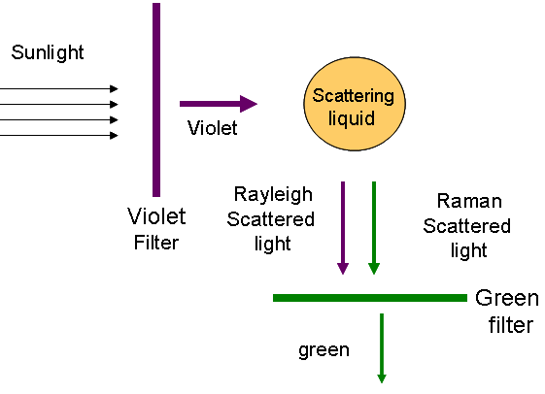
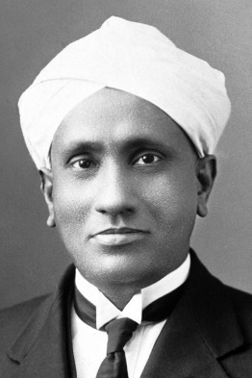
Basic Concepts
The Nobel Prize in Physics 1930 was awarded to Sir Chandrasekhara Venkata Raman "for his work on the scattering of light and for the discovery of the effect named after him."
Spontaneous Raman scattering can transfer a small fraction (about 10^{^-6}) of photons from one frequency to another, and the amount of frequency shift is determined by the vibrational modes of the medium.

Slide 4
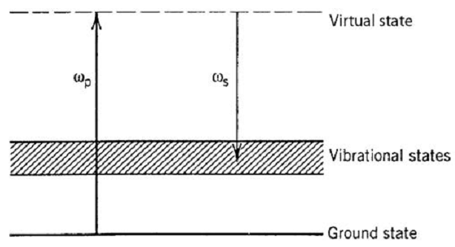
Basic Concepts
In any molecular medium, spontaneous Raman scattering can transfer a small fraction (typically ∼10⁻⁶) of power from one optical ﬁeld to another ﬁeld, whose frequency is downshifted by an amount determined by the vibrational modes of the medium. This process was discovered by Raman in 1928 and is known as the Raman effect.
It was observed in 1962 that, for intense pump ﬁelds, the nonlinear phenomenon of SRS can occur in which the Stokes wave grows rapidly inside the medium such that most of the pump energy is transferred to it.

Slide 5

Raman-Gain Spectrum
In a simple approach valid under the CW and quasi-CW conditions, the initial growth of the Stokes wave is described by
The Raman-gain coefﬁcient g_{R} is related to the cross section of spontaneous Raman scattering. On a more fundamental level, g_{R} is related to the imaginary part of the third-order nonlinear susceptibility.
In general, g_{R} depends on composition of the ﬁber core and can vary signiﬁcantly with the use of different dopants. It also depends on whether the pump and Stokes are copolarized or orthogonally polarized.

Slide 6
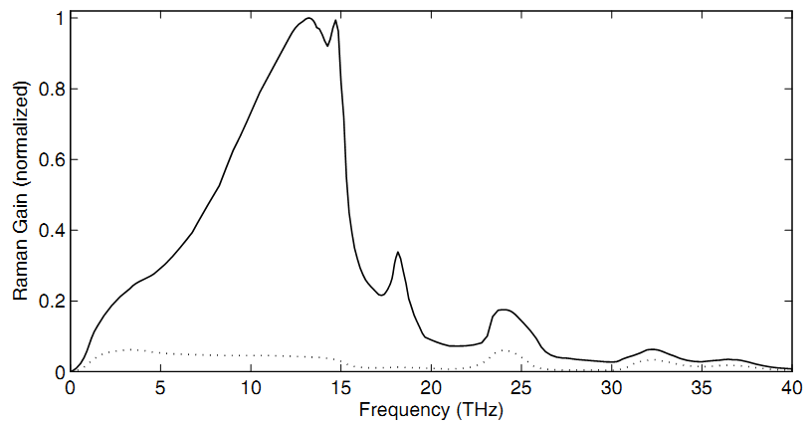


Raman-Gain Spectrum
The Stokes radiation is also copolarized with the pump because the Raman gain is relatively small when the two are orthogonally polarized.
The Raman gain in silica ﬁbers extends over a large frequency range (up to 40 THz), this behavior is due to the noncrystalline nature of silica glass. In amorphous materials such as fused silica, molecular vibrational
frequencies spread out into bands that overlap and create a continuum.

Slide 7






Raman Threshold
When the fiber loss, pump depletion and the pump-Stokes interaction are included, the SRS process is governed by a set of two coupled equations
Neglecting fiber losses, one can find that the total number of photons in the pump and Stokes beams remains constant during SRS.
To estimate the Raman threshold, we neglect pump depletion and obtain

Slide 8




Raman Threshold
The Stokes power can be calculated by considering ampliﬁcation of each frequency component and then integrating over the whole range of the Raman-gain spectrum.
Where
B_{eff} is the effective bandwidth of the Stokes radiation. Although B_{eff} depends on the pump intensity and the ﬁber length, the spectral width of the dominant peak provides an order-of-magnitude estimate for it.

Slide 9







Raman Threshold
The Raman threshold is deﬁned as the input pump power at which the Stokes power becomes equal to the pump power at the ﬁber output
Assuming α_{s} ≈ α_{p}, the threshold condition becomes
Assuming a Lorentzian shape for the Raman-gain spectrum, the critical pump power, to a good approximation, is given by
The threshold condition for the backward SRS is the same, except the numerical factor 16 is replaced with 20. If polarization is not preserved, the threshold is increased by a factor whose value lies between 1 and 2. The theory predicts a complete transfer of pump power to the Stokes.

Slide 10
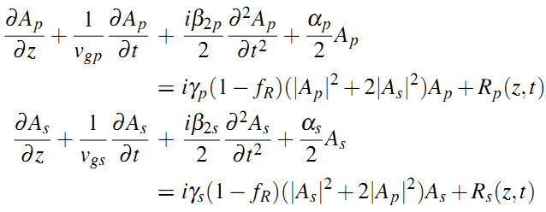
Coupled Amplitude Equations
For CW pumping, stimulated Brillouin scattering (SBS) dominates and inhibits SRS because of its lower threshold. However, SBS can be nearly suppressed by using pump pulses of widths <1 ns. Each pump pulse then generates a Stokes pulse if the SRS threshold is reached.
The dynamical description of SRS is considerably simpliﬁed because in fiber the respond is instantaneous. Except for ultrashort pump pulses (width ∼10 fs), the Raman response time is generally much smaller than typical pulse widths. The mutual interaction between the Raman and pump pulses is governed by a set of two coupled amplitude equations.

Slide 11
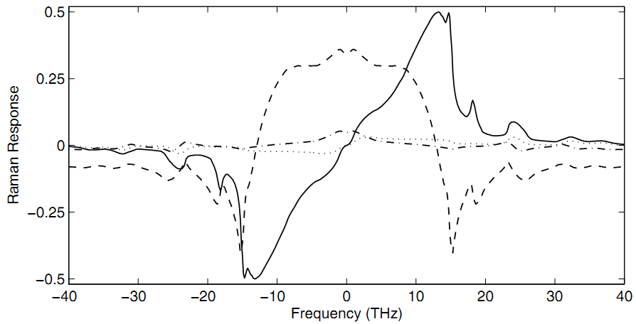

Coupled Amplitude Equations
For pulse widths exceed 1 ps, the pulse amplitudes vary little over the time scale over which the Raman response function h_{R}(t) changes. Thus, the Raman contributions, R_{p} and R_{s}, have the simpler form
Imaginary/parallel
Real/parallel
Imaginary/perpendicular
Real/perpendicular
Physically, the real part leads to Raman-induced index changes, while the imaginary part is related to the Raman gain.

Slide 12


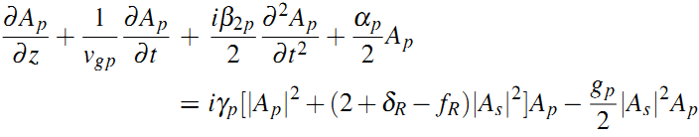
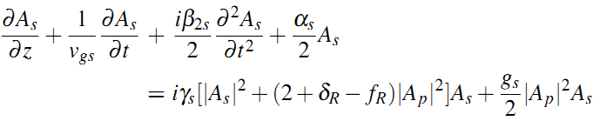
Coupled Amplitude Equations
Introducing the index and gain coefﬁcients
The coupled amplitude equations become
Note that the XPM factor is 2+δ_{R} − f_{R}, rather than being 2, when the Raman-induced index changes are included. The parameter f_{R} has a value of about 0.18. Even though the Raman-induced index change δ_{R} is relatively small in magnitude, its frequency dependence can affect the group velocity of the Stokes pulse.

Slide 13
Stimulated Raman Scattering
Basic Concepts
Quasi- Continuous SRS
SRS with Short Pump Pulses

Slide 14
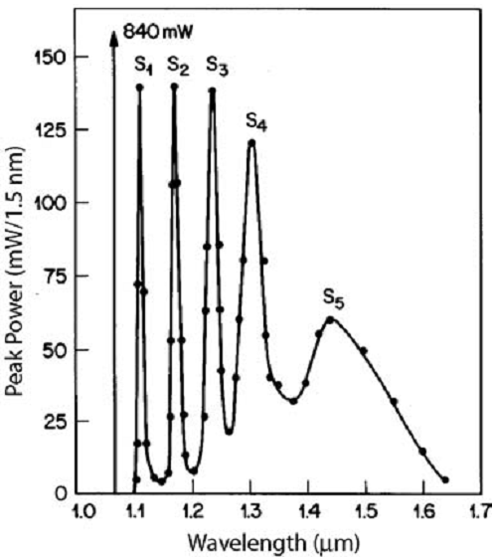
Single-Pass Raman Generation
In the single-pass geometry, each pump pulse launched at one end of the ﬁber generates a Stokes pulse at the other end.
Higher-order Stokes lines appeared at higher pump powers when the Stokes power became large enough to pump the next-order Stokes line.
Each successive Stokes line is broader than the preceding one.
Stokes line of up to the 15th order have been generated in the visible region.

Slide 15
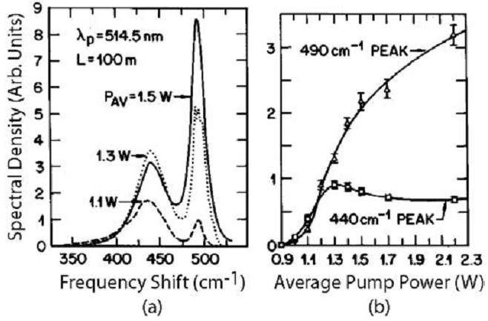
Single-Pass Raman Generation
At low pump powers, the Stokes growth looks like exponential because of the exponential ampliﬁcation process. As pump power is increased, the high-frequency peak can pump the low-frequency peak through the Raman-ampliﬁcation process. Eventually, the Stokes power becomes high enough to generate a second-order Stokes line.

Slide 16
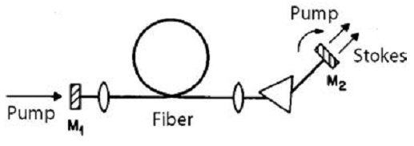

Raman Fiber Lasers
Fiber-based Raman lasers can be tuned over a wide frequency range.
The Fabry–Perot cavity formed by two partially reﬂecting mirrors provides wavelength-selective feedback for the Stokes light generated inside the ﬁber through SRS.
An intracavity prism allows tuning of the laser wavelength by dispersing various Stokes wavelengths spatially, each of which can be selected by turning the mirror M₂.
The laser threshold corresponds to the pump power at which Raman ampliﬁcation during a round trip is large enough to balance cavity losses.
The threshold pump power for a Raman laser is lower by at least one order of magnitude than that of single-pass SRS.

Slide 17
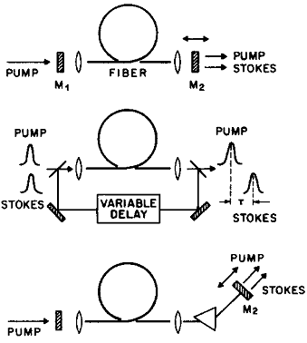


Raman Fiber Lasers
When a Raman laser is pumped by a train of pump pulses, each Raman pulse after one round trip should be properly synchronized with one of the succeeding pump pulses.
One can select a particular wavelength that fulﬁlls the synchronous-
pumping requirement among the wide range of possible wavelengths near the peak of the Raman-gain spectrum. Moreover, the laser wavelength can be tuned by simply changing the cavity length. This technique is referred to as time-dispersion tuning.
If the cavity length is changed by ΔL, the time delay Δt should be exactly compensated by a wavelength change Δλ such that
The tuning rate is therefore given by
R. Stolen, et al, APL, 1977.

Slide 18




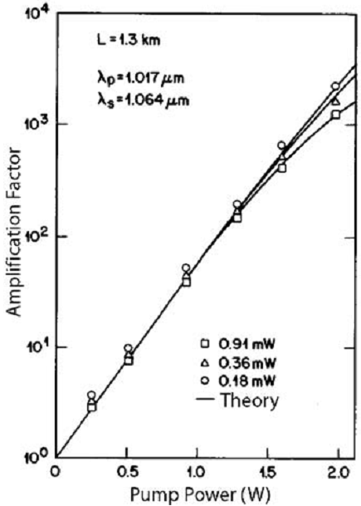


Raman Fiber Ampliﬁers
Optical ﬁbers can be used to amplify a weak signal if that signal is launched together with a strong pump wave such that their frequency difference lies within the bandwidth of the Raman-gain spectrum. If the pump depletion can be ignored, the ampliﬁcation factor is given by
The ampliﬁcation factor GA increases exponentially with P₀ initially but starts to deviate for P₀ > 1 W. This is due to gain saturation occurring because of pump depletion. The saturated gain of the ampliﬁer is given by
Where

Slide 19
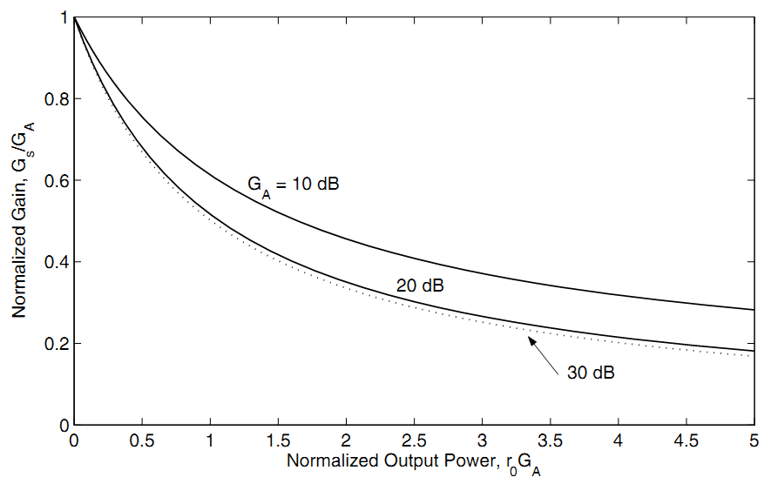
Raman Fiber Ampliﬁers
The saturated gain is reduced by a factor of two when G_{A}r₀ ≈ 1. P₀ is a good measure of the saturation power of Raman ampliﬁers. The saturation power of Raman ampliﬁers is much larger compared with that of doped-ﬁber ampliﬁers or semiconductor optical ampliﬁers.

Slide 20
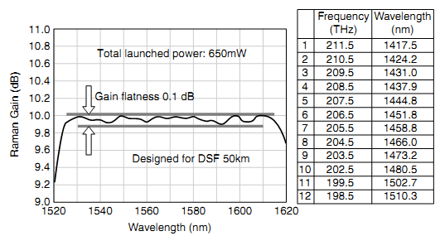
Raman Fiber Ampliﬁers
For optimum performance of Raman ampliﬁers, the frequency difference between the pump and signal beams should correspond to the peak of the Raman gain.
An attractive feature of Raman ampliﬁers is related to their broad bandwidth. It can be used to amplify several channels simultaneously in a WDM lightwave system. Also, Raman ampliﬁers can be used to extend the bandwidth of WDM systems operating in the 1.55-μm region (40nm->80nm and beyond).
S. Namiki, et al, OFC, 2000.

Slide 21
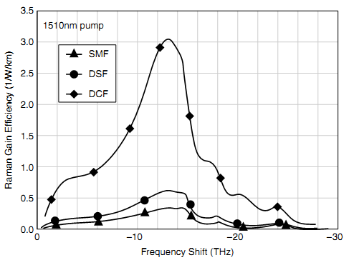
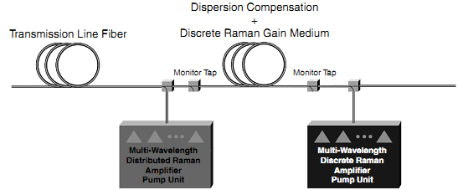
Raman Fiber Ampliﬁers
There is more than a tenfold increase in gain efﬁciency in commercial dispersion-compensating ﬁber compared to standard single-mode ﬁber.
Mohammed N. Islam, RAFT, 2004
S. Namiki, et al, OFC, 2000.

Slide 22



Raman-Induced Crosstalk
In a WDM system, short-wavelength channel can act as a pump for longer-wavelength channels and thus transfer part of the pulse energy to
neighboring channels. This leads to Raman-induced crosstalk among channels that can affect the system performance considerably. The ampliﬁcation factor G_{s} for the longer-wavelength channel and the associated reduction in the short-wavelength channel power are
Where

Slide 23
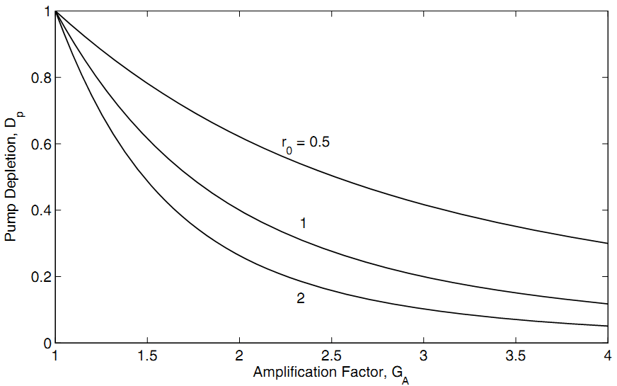

Raman-Induced Crosstalk
These curves can be used to obtain the Raman-induced power penalty deﬁned as the relative increase in the pump power necessary to maintain the same level of output power as that in the absence of Raman crosstalk. The power penalty can be written as (in decibels)

Slide 24
Stimulated Raman Scattering
Basic Concepts
Quasi-CW SRS
SRS with Short Pump Pulses

Slide 25







Pulse-Propagation Equations
For ultrashort pulses of widths below 100 ps, typically L_{W} < L. SRS is then limited by the group-velocity mismatch and occurs only over distances z ∼ L_{W}.
At the same time, the nonlinear effects such as SPM and XPM become important because of relatively large peak powers and affect considerably the evolution of both pump and Raman pulses.
Here we consider the case where pulse widths are assumed to be larger than the Raman response time (∼50 fs) so that transient effects are negligible. When fiber losses are ignored, the evolution of amplitudes of the pump and the Stokes waves can be expressed in the retarded frame:
Where
Note that

Slide 26

Pulse-Propagation Equations
Four length scales can be introduced to determine the relative importance of various terms in the coupled equations. For pump pulses of duration T₀ and peak power P₀, these are deﬁned as
Typically, L_{W} ∼1 m (for T₀ < 10 ps) while L_{NL} and L_{G} become smaller or comparable to it for P₀ >100 W. In contrast, L_{D} ∼ 1 km for T₀ = 10 ps. Thus, the GVD effects are generally negligible for pulses as short as 10ps. The situation changes for pulse widths ∼1ps or less because L_{D} decreases faster than L_{W} with a decrease in the pulse width. The GVD effects can then affect SRS evolution signiﬁcantly, especially in the anomalous-dispersion regime.

Slide 27


Pulse-Propagation Equations
Neglected GVD and pump depletion, the pump pulse has the solution as
(XPM ignored)
For the Raman pulse
(SPM ignored)
Where
The pump pulse of initial amplitude A_{p}(0,T) propagates without change in its shape. The SPM-induced phase shift imposes a frequency chirp
on the pump pulse that broadens its spectrum. The Stokes pulse, by contrast, changes both its shape and spectrum as it propagates through the ﬁber. Temporal changes occur owing to Raman gain while spectral changes have their origin in XPM.
Because of pulse walk-off, both kinds of changes are governed by an overlap factor ψ(z,T) that takes into account the relative separation between the two pulses along the ﬁber. This factor depends on the pulse shape.

Slide 28



Effects of GVD
When the ﬁber length is comparable to the dispersion length L_{D}, it is important to include the GVD effects. For numerical purposes, it is useful to introduce the normalized variables. A relevant length scale along the ﬁber length is provided by the walk-off length L_{W}. By deﬁning
The coupled equations become
Where

Slide 29
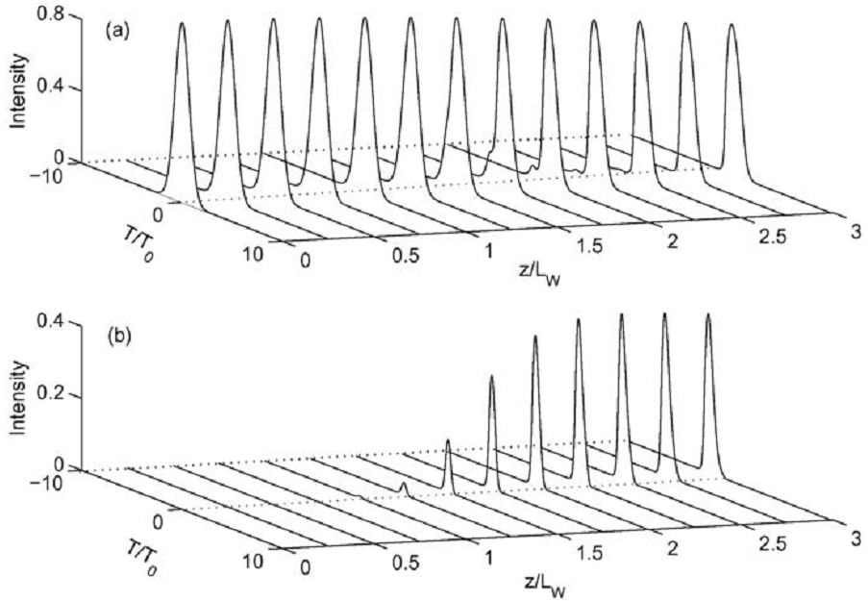


Effects of GVD
The Raman pulse starts to build up after 1L_{W}. Energy transfer is nearly complete by z=3L_{W} because the two pulses are then physically separated. As the Stokes pulse moves faster, the energy for SRS comes from the leading edge of the pump pulse.

Slide 30
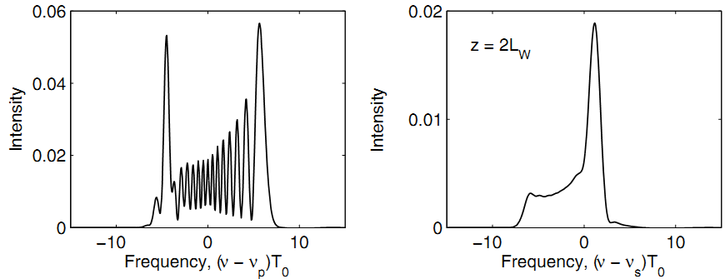
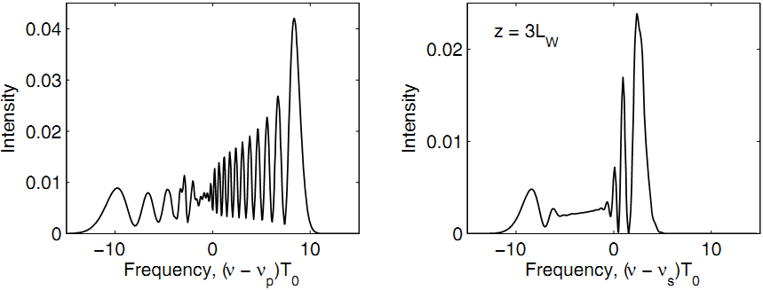
Effects of GVD
The asymmetry of these spectra is due to XPM-induced chirp. The high frequency side of the pump spectra exhibits an oscillatory structure that is characteristic of SPM.
As the low-frequency components occur near the leading edge of the pump pulse and because the pump is depleted on the leading side, the energy is transferred mainly from the low-frequency components of the pump pulse.

